Slide 1
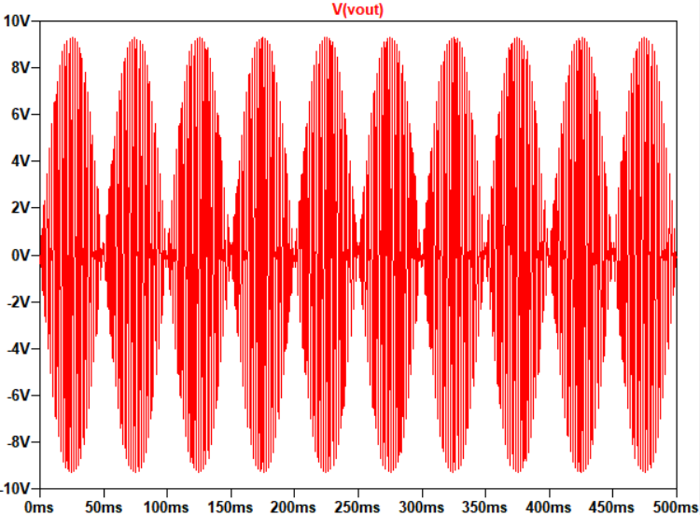
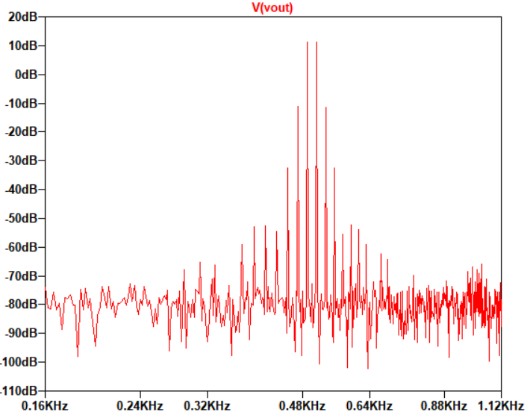
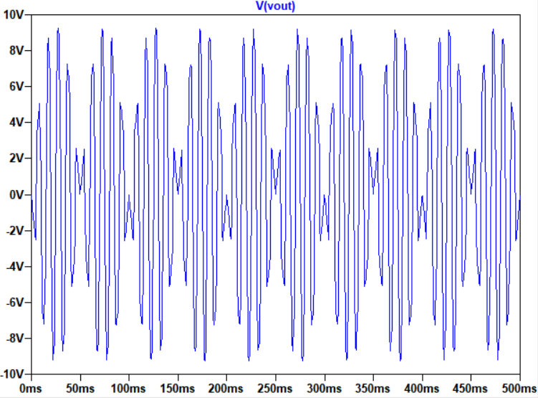
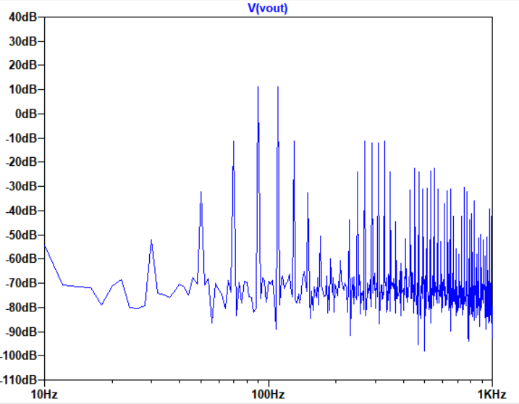
Time and frequency domain response for diode and opamps based modulator
useful frequencies
20dB
useful frequencies
20dB

Slide 2
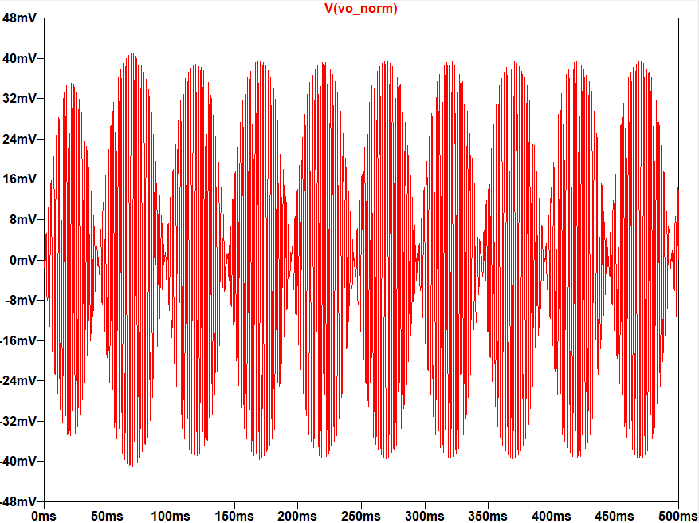
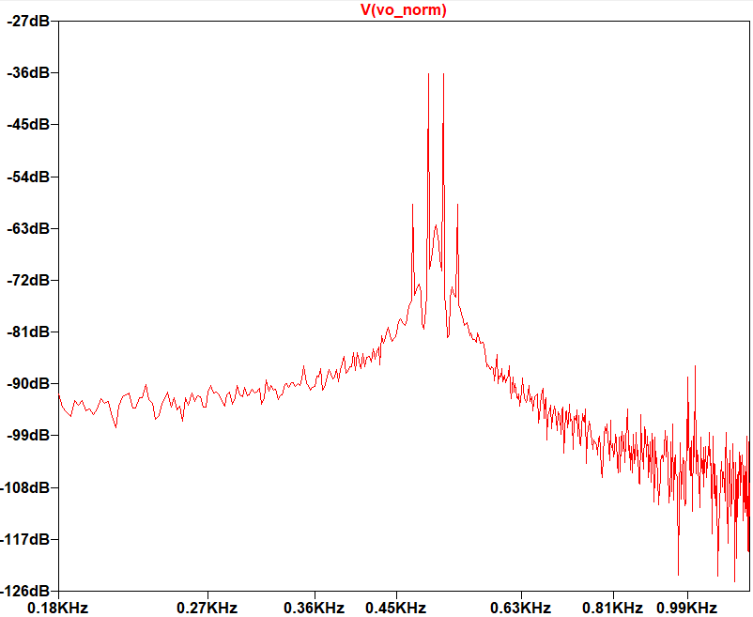
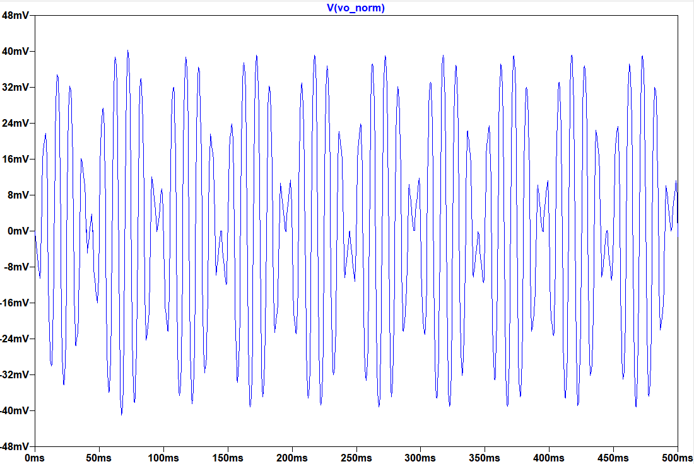
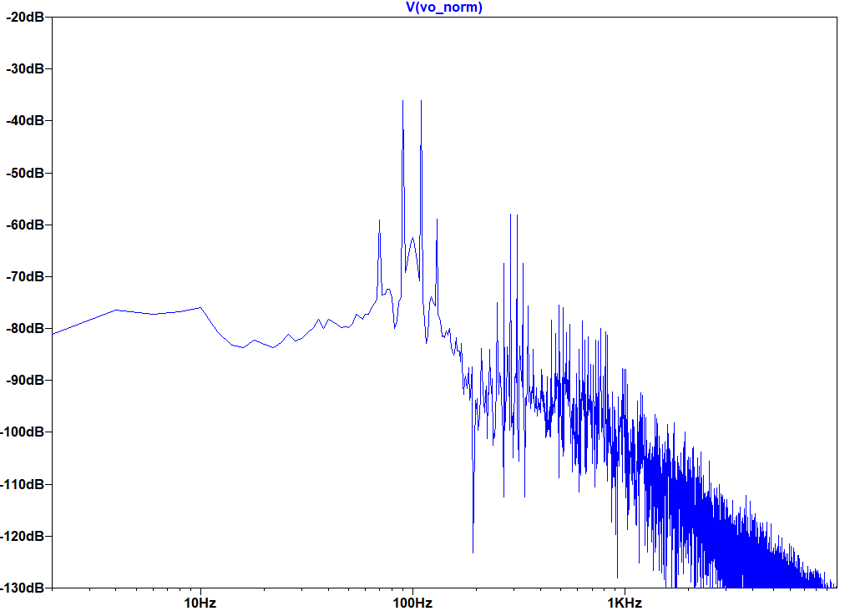
Time and frequency domain response for MOSFET and opamps based modulator
useful frequencies
36 dB
useful frequencies
40dB

Slide 3
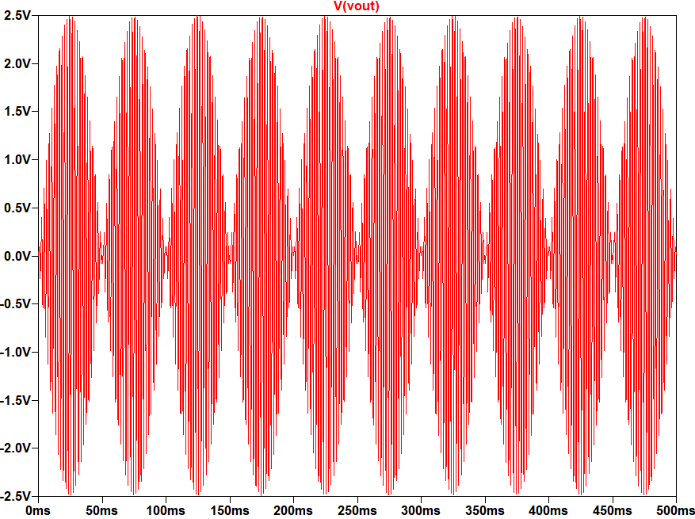
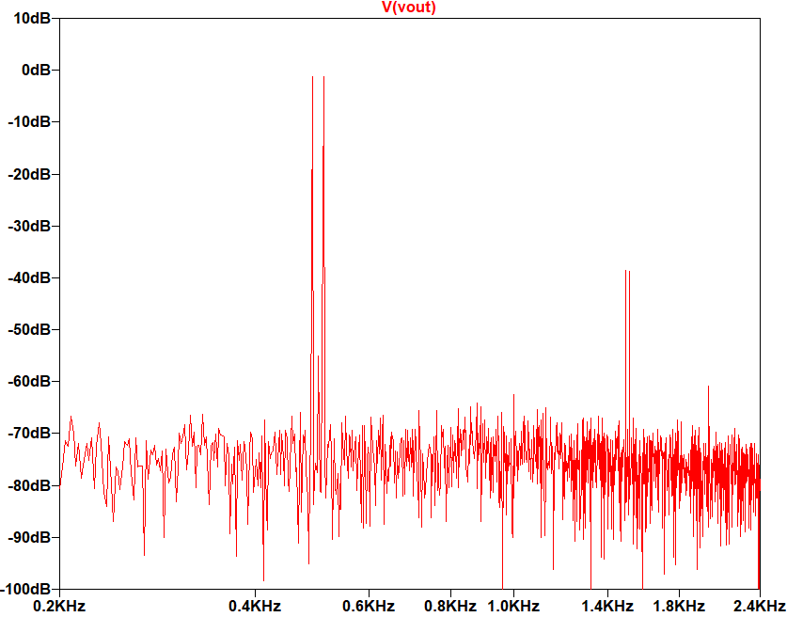
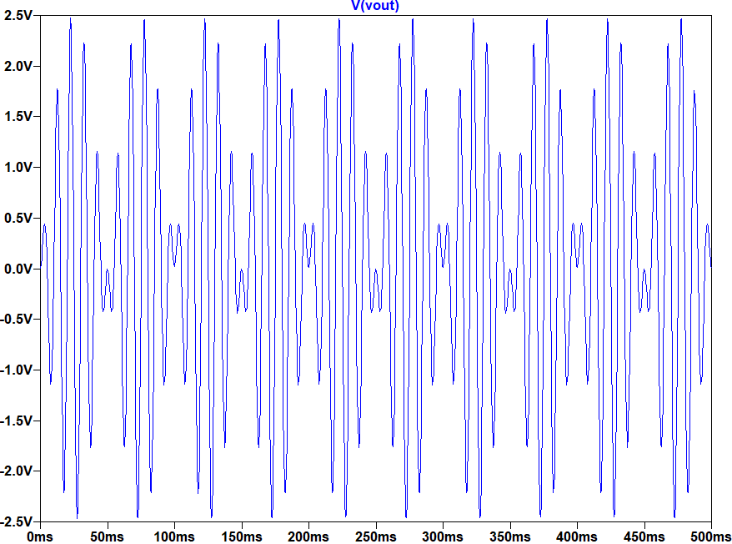
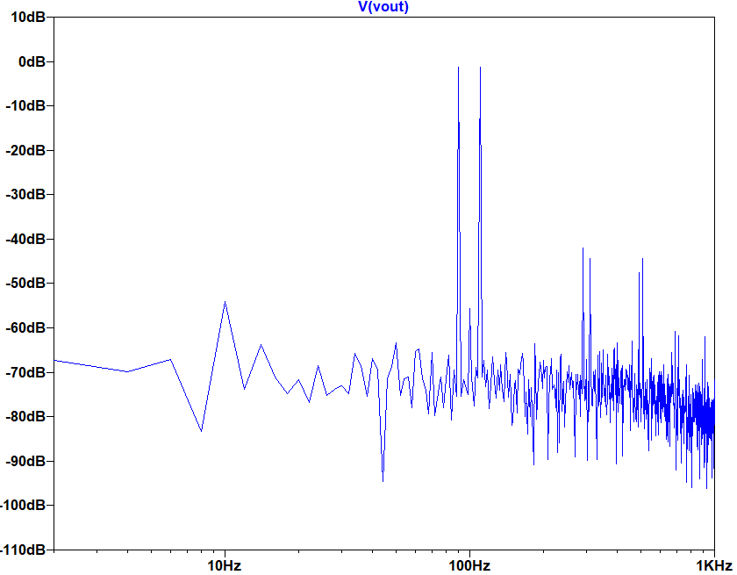
Time and frequency domain response for AD633 IC based modulator
useful frequencies
40 dB
useful frequencies
50dB

Slide 4
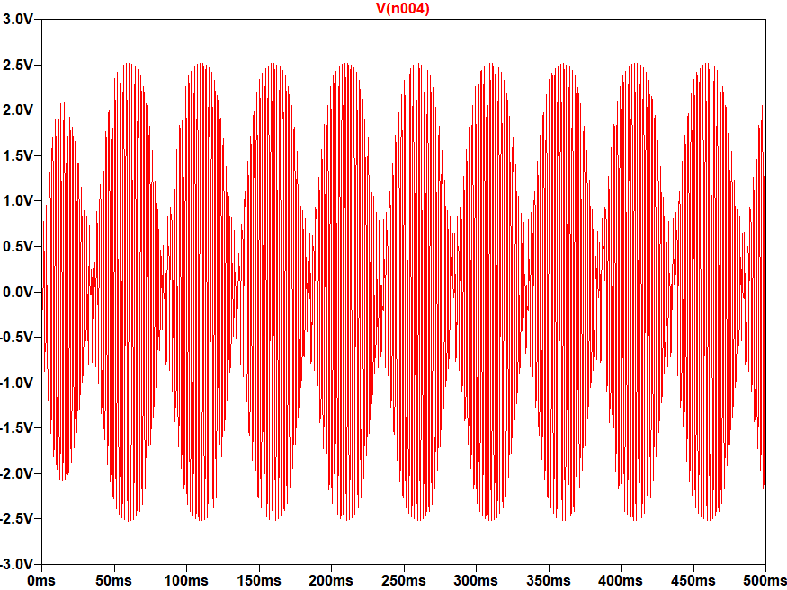
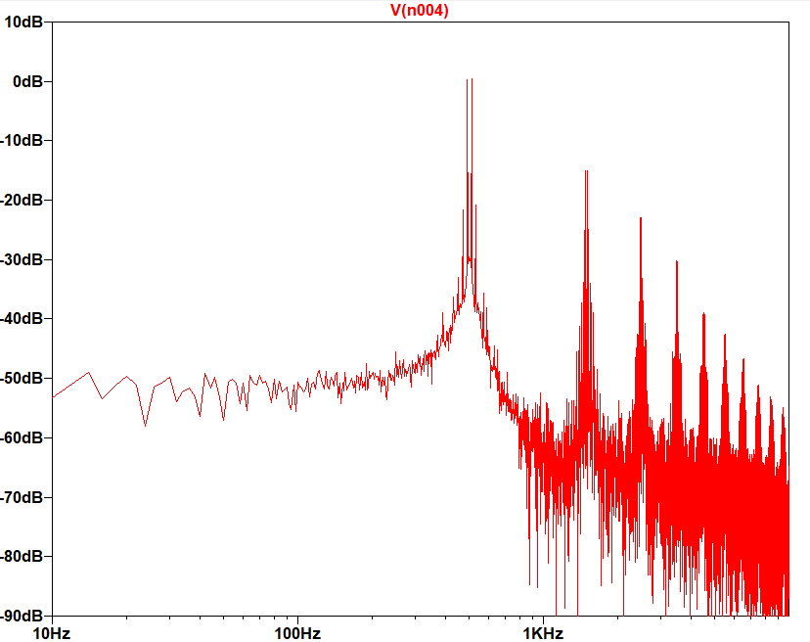
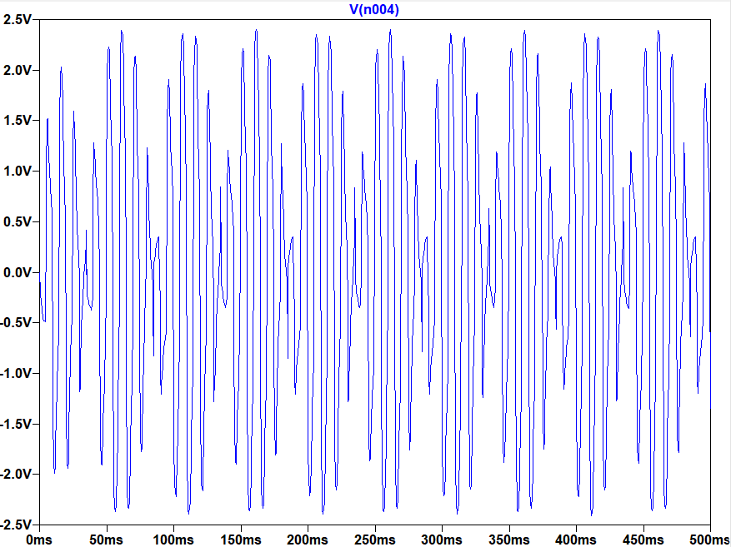
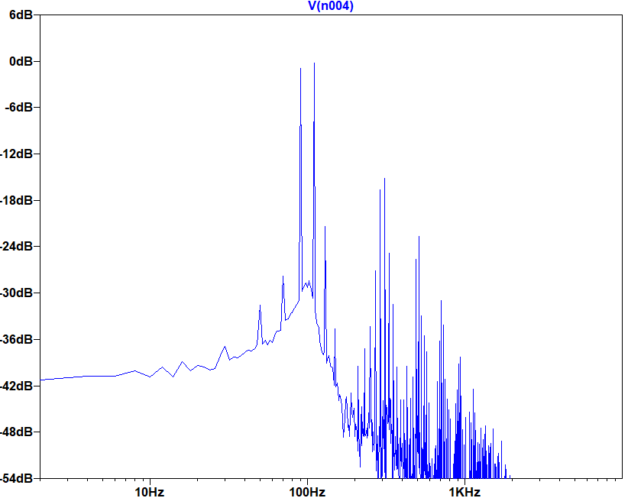
Time and frequency domain response for transformer and diodes based modulator
useful frequencies
20dB
useful frequencies
15 dB

Slide 5
Time and frequency domain response for transformer and diodes based modulator
useful frequencies
20dB

Slide 6
Time and frequency domain response for diode and op-amps based modulator
useful frequencies
20dB

Slide 7
Time and frequency domain response for MOSFET and op-amps based modulator
useful frequencies
36 dB

Slide 8
Time and frequency domain response for AD633 IC based modulator
useful frequencies
40 dB

